Slide 1
Cloud Computing, an introduction
By Alireza Mirzaei
IT Fundamentals, Dr. Basiri

Slide 2
Presentation
Outline
Introduction
Benefits of cloud computing
Cloud computing challenges
Cloud computing services and types
Cloud computing trends
Conclusion

Slide 3
Introduction

Slide 4
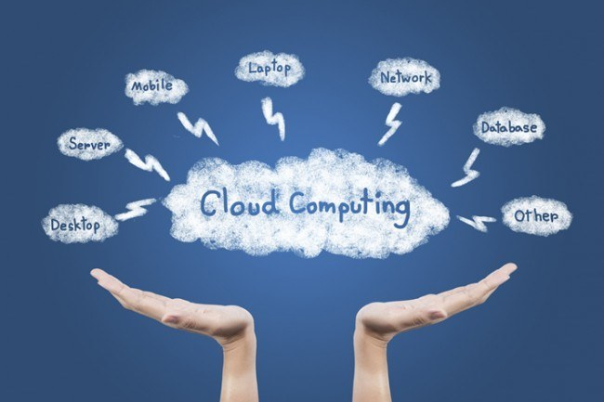
Introduction
Cloud?
Cloud Computing definition.
Why?
Notes:
به دریافت در لحظه‌ی منابع، داده‌ها، نرم‌افزارها و گزارشات از یک سیستم “ابری” گفته می‌شود
a global network of remote servers that operates as a single ecosystem, commonly associated with the Internet
باعث میشه که انعطاف بالاتر بره، شرکت‌ها هزینه‌ی زیرساخت برای خودشون ندن. باعث بهینگی و کاهش هزینه از لحاظ آی‌تی میشه. (اسلاید بعدی)

Slide 5
The benefits of “☁️”

Slide 6
Benefits of cloud computing
Scalable
Scaling up and down is very easy and fast for companies.
Cost-saver
Physical hardware and maintenance are removed. Pay-as-you-go saves costs.
Secure
Big Investments in security done by cloud service providers for protecting clients data.
Mobile
With just an internet connection, employees can access data and applications from all around the world.
Notes:
Scalability: With cloud computing, organizations can easily scale up or down their computing resources based on their current needs. This flexibility helps reduce costs associated with underutilized resources.
Cost Savings: Cloud computing eliminates the need for capital expenditures in the form of physical hardware and maintenance costs. Pay-as-you-go models also help organizations save costs.
Security: Cloud service providers invest heavily in security measures to protect their clients' data. The chances of data loss or theft are reduced as compared to traditional on-premises setups.
Mobility: Cloud computing enables employees to access data and applications from anywhere in the world, provided they have an internet connectio

Slide 7
Challenges of
“☁️”

Slide 8
Challenges of cloud computing
Compliance
Processing sensitive data on the internet.
GDPR, HIPAA.
Security
There’s always the danger of data loss or theft.
Attacks on the provider can cause downtime.
Internet connectivity
Disruption in connection means downtime and productivity (money) loss.
Notes:
Security: Although cloud providers invest heavily in security measures, there is always a risk of data loss or theft.
Dependence on Internet Connectivity: Cloud computing relies heavily on stable internet connectivity. Any disruptions in internet connectivity can cause downtime and loss of productivity.
Compliance: Organizations must ensure compliance with regulations such as GDPR and HIPAA when storing and processing sensitive data on the cloud.
GDPR: قوانین عمومی محافظت از داده
HIPAA: جنبش محافظت از داده‌های سلامتی

Slide 9
“☁️”
Services and types

Slide 10
Cloud types (1)
Public
Virtually limitless scalability
Very cost-effective.
No maintenance.
Reliability worries due to dependency on another company.
Security problems due to being “public”.
This being the go-to way for starting companies, the popularity of this method will keep growing.

Slide 11
Cloud types (2)
Private
Enhanced security, as secure as the company needs it to be.
Customizable for the company needs.
Can be on-premises or third-party managed.
Much higher costs for the company.
And way less scalable.

Slide 12
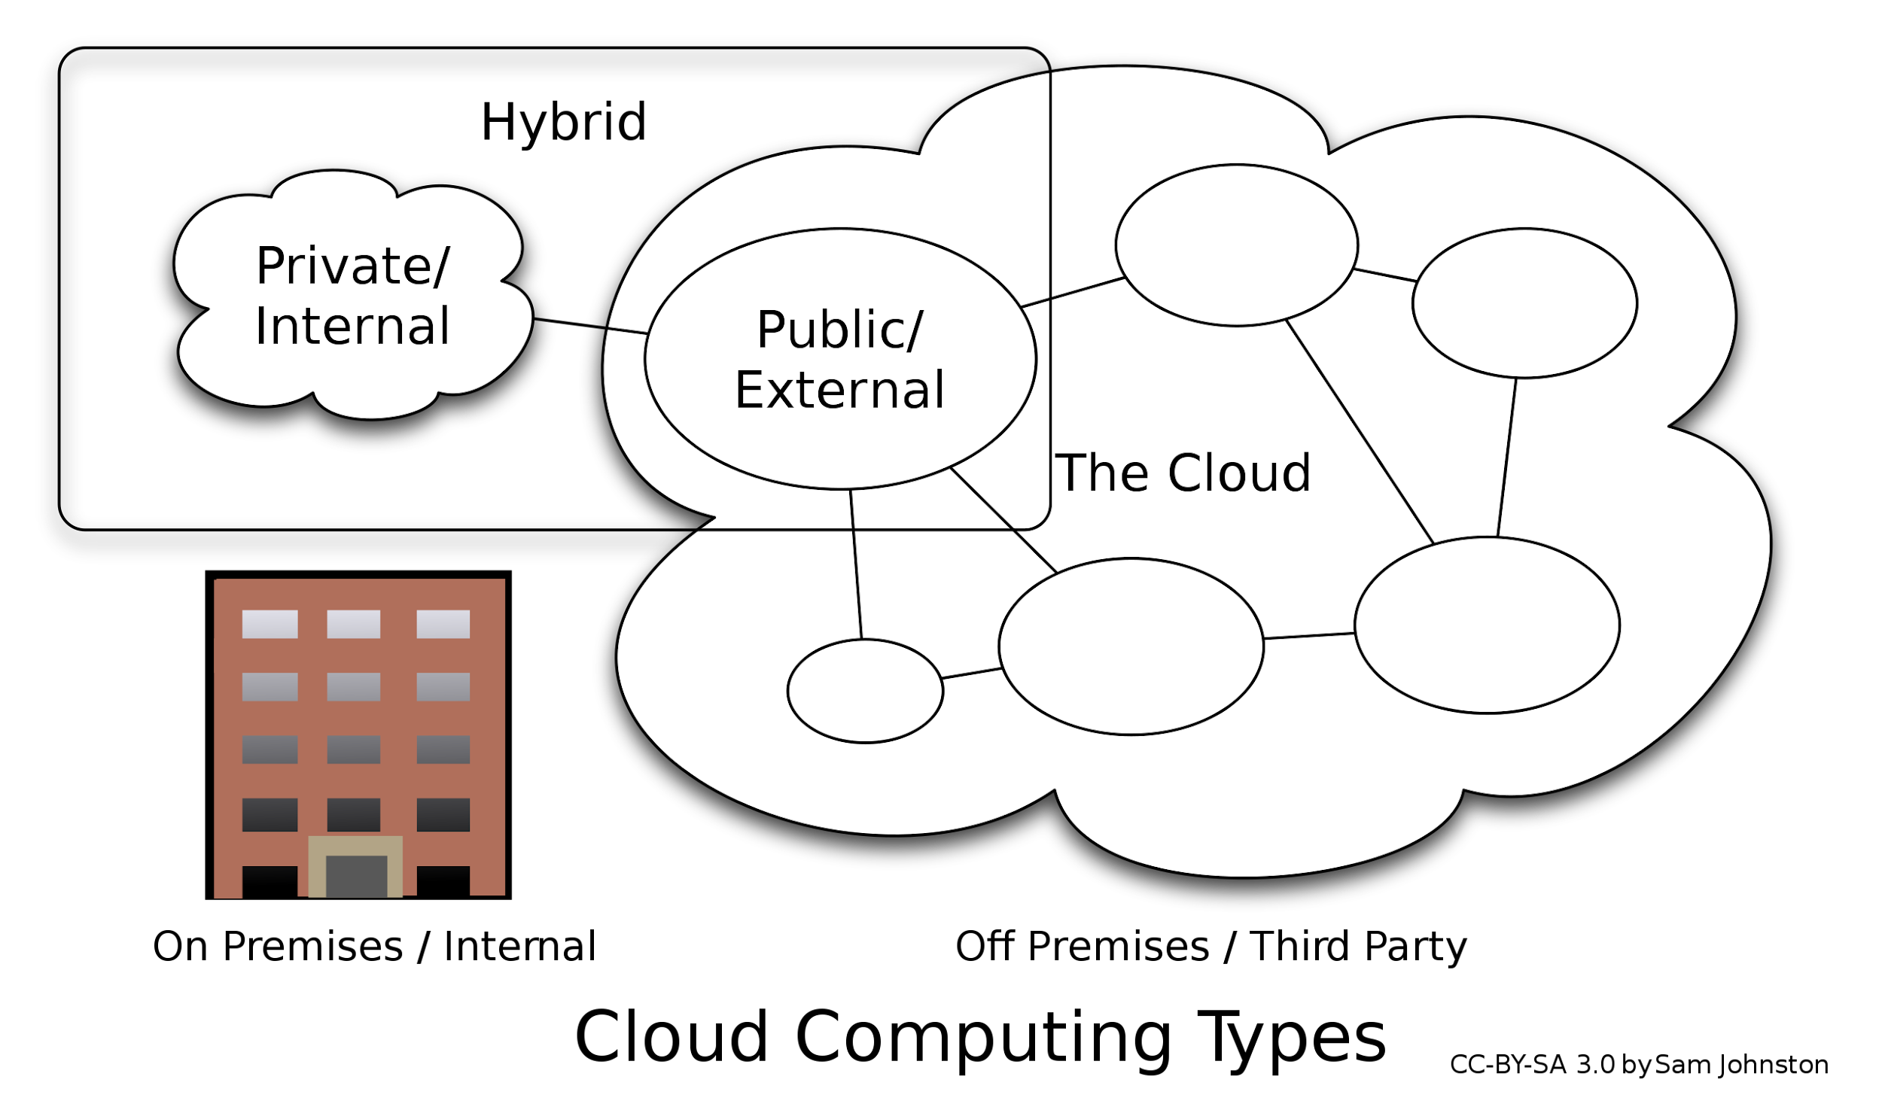
Cloud types (3)
Hybrid
Best of both worlds!
Scalability and flexibility are both there.
And it’s cost-effective too, but…
Integration means complexity.
Security between two worlds.
Dependency on third-party companies.
Notes:
مقیاس پذیری،‌ انعطاف و شخصی سازی

Slide 13
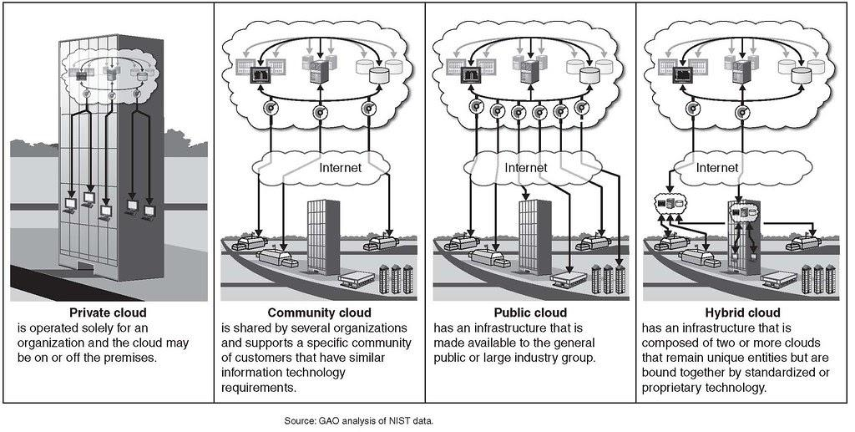
Recap of the types of cloud computing

Slide 14
Cloud Services
4 Levels of service are defined
Infrastructure as a Service (IaaS)
Platform as a Service (PaaS)
Serverless Computing
Software as a Service

Slide 15
Cloud Services (1)
IaaS (Infrastructure as a service)
Raw virtualized resources provided.
Complete control over OS, software, networking, etc.
No infrastructure maintenance.
AWS, Azure, Google compute engine, etc. are some of the providers.
Being “raw” means less default security measures.
Requires more technical expertise in different fields, specially DevOps.

Slide 16
Cloud Services (2)
PaaS (Platform as a service)
Shared hardware for clients, reducing hardware costs.
Platform pre-configured with tools for developing and deploying apps.
Quick scaling down and up options.
Heroku, Google App Engine, and Azure are some providers.
Locks and limits on tools and proprietary tech.
Security risks.
Internet speed limits on some areas.

Slide 17
Cloud Services (3)
Serverless Computing
Exactly like PaaS in terms of Infrastructure.
Lack of resources isn’t a problem anymore!
You don’t pay for idle times.
Better for apps with unpredictable traffic patterns.
Exactly like PaaS

Slide 18
Cloud Services (4)
SaaS (Software as a service)
Office 365, E-Mail, CRM and ERP services are some examples of this.
Accessed through a web-page or an application.
No worry about the underlying infrastructure.
Very easily and cheaply deployed.
Proprietary apps are not very customizable.
Performance issues exist very often.
Dependency always causes worries.

Slide 19
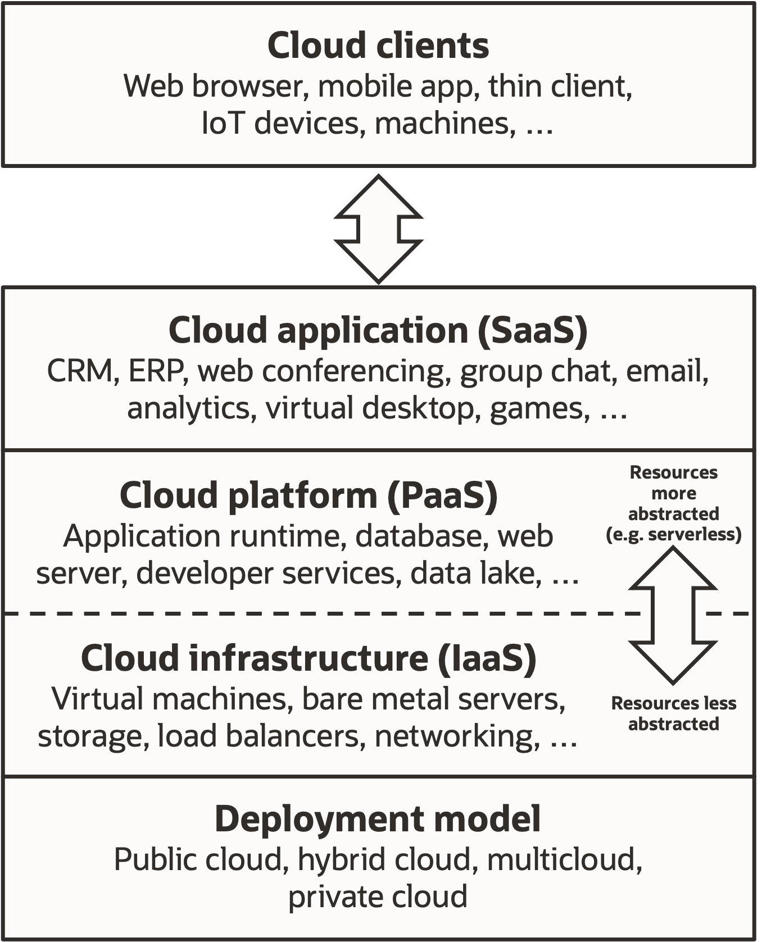
Recap of the services of cloud computing

Slide 20
The trends of “☁️”

Slide 21
Trends
Hybrid and Multi-Cloud Adoption.
Edge Computing.
Serverless Computing.
Artificial Intelligence.
Containerization, Docker and Kubernetes.
Notes:
Companies are increasingly adopting hybrid and multi-cloud strategies to leverage the benefits of different cloud providers and architectures. This enables them to choose the best-fit cloud solution for their specific business needs, while avoiding vendor lock-in.
Kubernetes manages resources, automates deployment, etc. docker is the container itself that allows consistent applications through different oses and platforms, etc.

Slide 22
Conclusion
Cloud computing has already revolutionized the IT industry in many ways, and it is expected to continue doing so in the future. Cloud computing will continue to play a significant role in shaping the IT industry in the future too. Its’ ability to provide scalable, cost-effective, and flexible IT resources will enable businesses to innovate and compete in an ever-changing digital landscape.

